Slide 1
#norwich2040

Slide 2
Our inclusive economy:
more opportunities for more people
Adam Clark
Norwich City Council

Slide 3
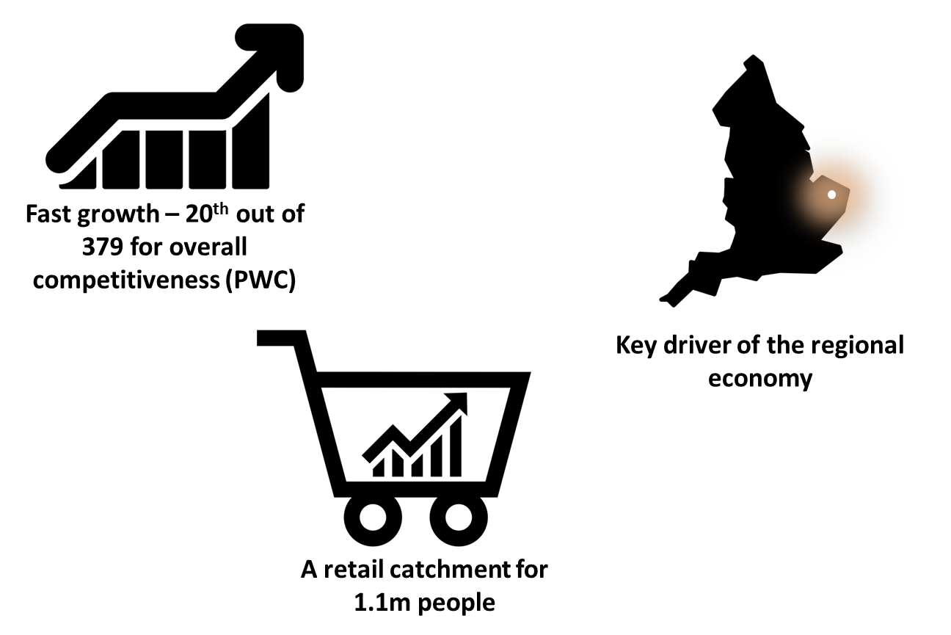
Norwich is…
Notes:
As was identified by the vision engagement piece Norwich is a great place to live and a great place for businesses.
The city is identified as being part of the Fast Growth Cities network, ranked 20/379 for overall competitiveness on the PWC Index 2016. Recent GVA report: “The economic dynamism of the city underpins the regional economy and as such its significance as an economic driver, attractor of investment and of skilled labour must not be underestimated”
Even with the current national issues and challenges for the high st as we’ve seen with House of Fraser, Norwich remains a major Retail destination centre with diversity and character – award-winning Norwich market, The Lanes and little gems like The Book Hive, to trusted regional brands like Jarrolds and major national retailers who choose to do business here.
With very limited competition from other retail centres, the city exerts a very strong pull over an extraordinarily extended physical catchment area. CACI assesses the Norwich catchment as standing at 1.1M. This analysis is backed up by Space Syntax’s gravitational mapping, which highlights that, after London, Norwich has the second most dependent catchment populations in the South East.

Slide 4
Norwich has…
Notes:
As well as retail, Norwich boasts global businesses like Aviva, thriving sectors – the technation report deemed us a dynamic digital cluster - we have a significant cultural sector e.g. arts centre, writers centre, which provides employment, and bring visitors and investment. We have cutting edge social enterprises like The Feed and Your Own Place that are showing the way to the rest of the country. And 2 High quality universities – UEA is consistently in the top 20 UK universities, with world-leading work around climate change, creative writing etc whilst NUA’s Games art and design course is in the top 10 gaming courses in the world.

Slide 5
But Norwich also has…
Notes:
But the other side of the coin is low social mobility, low wages and high levels of inequality in terms of health, wealth, quality of life and life expectancy. So why?
Clearly there is a combination of National drivers and Local factors that drive long-standing structural, intergenerational issues that see persistent patterns of low social mobility in particular communities – sometimes even the same families
Some people say there is a lack of aspiration – but as Dan Mobbs said at last year’s conference, no-one is born without aspiration, though life may knock it out of them pretty quickly. In fact there is a growing body of evidence that Adverse Childhood Experiences (such as neglect, abuse and parental mental health issues) have an impact on inequality and unrealised potential. So although interventions to enhance social mobility that focus on school and workplace are important, the role of early childhood should not be ignored. A recent American study stated that “the rate of return on investment in human capital in early childhood is much greater than the rate of return on investment in human capital during later childhood and adulthood. Making early childhood investments in disadvantaged children is not only the fair thing to do but the societal rate of return to early childhood investment in disadvantaged children is relatively high. So it makes sense from a productivity standpoint”
Another study showed that Less-gifted children from higher-income families end up with more impressive qualifications than more-gifted children from lower-income families, so again there is an interaction between innate potential and a wider context that allows that potential to be realised
Maybe the lack of ambition lies in us collectively – maybe we lack the aspiration (or the hope) that things can be different. But isn’t that the point of having a vision?

Slide 6
What do we do?
Notes:
Here’s an outline of 4 steps that we can take that will help to address some of the lack of inclusion in our economy, whilst preserving and working with the undoubted assets that the city has:
Dream big. Again, let’s not lack aspiration for ourselves, let’s not fail because we didn’t dream big enough. Let’s set a long-term vision, because we won’t achieve anything by simply aiming at changes over a year or 3 driven by events and the need to make savings to the public purse. Because the children being born now are the ones who will be the ones who are entering the workforce in 2040, and as Alan has said, it’s going to be a very different labour market. We can’t know precisely what knowledge and skills that generation will need, but NESTA future skills work suggests that there will be greater demand for interpersonal skills, and higher-order cognitive skills – and what we do know is that those skills are difficult to develop in a home environment which is not safe or is traumatising in the first few years of life.
Marshall our evidence.
Use the growing body of academic and think tank research that is reframing the discussion around inclusive and good growth, including Thomas Piketty’s work on inequality, Kate Raworth’s ‘Donut economics’ about economic growth within social and environmental limits, Paul Collier’s work on The Future of Capitalism.
Learn from others – Preston’s work around the local economy which has resulted in it being deemed the ‘most improved town’ in the PWC/DEMOS Good Growth Index 2018. And Bristol and Glasgow who are leading the way in terms of the place-shaping agenda using civic and university partnerships. And we can look further afield in Europe and the rest of the world for good examples of urban policy that is sustainable, inclusive and positive.
And learn from ourselves and what has already worked – Norwich is increasingly a Living Wage city with the city council and Aviva leading the way and now the UEA coming on board. And this is starting to influence the wider market – how long will businesses in Norwich who don’t pay the living wage be able to attract decent staff, especially after Brexit?
And again we have existing local assets in terms of the UEA’s research capacity and appetite to contribute to Norwich, and data research that we as a council have around the labour market and the local economy, as well.
The city council are working with the UEA to look at how we can bring all this together through scoping a Norwich Inclusive Economy Commission to build an evidence base about the local economy and what we can collectively do to make it more inclusive – whether that be about employment conditions, the impact of our supply chain on environmental and social outcomes or providing routes into learning and employment for groups who traditionally would not thrive in the labour market due to education, poverty or health. So we will be talking to a range of stakeholders about that over coming months. And that evidence must also continue to be informed by the lived experience of residents from all backgrounds, as we have done with the overall vision, and especially the voices of young people in the way that Create Norwich will talk about.
Marshall our forces
This is where the evidence base needs to include an understanding of our collective ‘clout’ – of the big ‘anchor institutions’ from across public, private and third sector, as well as the range of assets that our wider business and community can bring to bear on the agenda, whether that be mentoring, or providing apprentices so we know what we’re working with. And also the role of the wider local public sector, regional players like the LEP and national government
Let’s face it, Brexit, climate change, AI , automation and global economic patterns are going to happen whatever we do in Norwich, so let’s try and turn those threats into opportunities – and the best way we can do that is by using the biggest untapped asset we have locally – our people - and particularly those of our neighbours who are not economically active, and not reaching their potential. Because we’re probably going to lose skilled and unskilled labour through Brexit, and our traditional low-wage jobs are going to go or change massively – can we bring that new demand together with a new supply, and shape the growth, regeneration, infrastructure projects and social investment (e.g. social mobility opportunity area, work programme and wider skills programmes) that will happen anyway around a coherent agenda? So a challenge to all of us is what can we do to ensure that the new technologies that grow up in response to climate change are delivered by the children being born now in households where the parents think that work can only mean zero hours contracts and minimum wages in retail, hospitality and care. Because I suspect that many of the teenagers in those households today are maybe more likely to see county lines as a way of realising their dreams rather than work.
Set our shared direction – until we’ve gone through those first stages, we can’t be specific but we do know that we will not achieve anything in silos. And we may need to be holistic in our thinking – because though economic activity, skills development, investment and regeneration may be necessary, but they will not be sufficient if we’re going to achieve anything. Other interventions needed may not be explicitly ‘economic’ in nature – they may be about health, wellbeing and community first and foremost. But the benefits will be social and economic. And of course we all have different roles to play – yes, we need to have different methodologies, different approaches, and play to our individual strengths but those have to be cohered by a shared sense of where we’re trying to get to and underpinned by the optimism, resilience and relationships to flex as we go, and respond to the whirlygig of change that is the modern world. We can’t fix the path, but we can evolve a collaborative approach and agree a destination. And we want Norwich Inclusive Economy Commission to be a first and crucial stage on that journey.

