Slide 2
Campaign video

Slide 3
Our purpose
Shelter exists to defend the right to a safe home
We strive for change with individuals, in communities, in society

Slide 4
Our change mantras
Shelter will change the country
Our enemy is social injustice
We are all one Shelter
We say what we believe
We only do what meets our purpose

Slide 5
Ten-year impact statement
The enforceable right to a safe, decent and affordable home
Everyone who needs it has publicly funded housing
People who rent have the right to a permanent home
Everyone can assert their housing rights, and no one is discriminated against, stigmatised or marginalised because of housing need

Slide 6
Impact statement for 2019-2022 strategy
Given the gravity of the national emergency, our priority will be the 6 million households whose right to a home is denied or under threat.
All political parties promise to build enough public housing
Renters have greater security and do not face discrimination
People who struggle to manage their housing have support

Slide 7
How we will achieve change

Slide 8
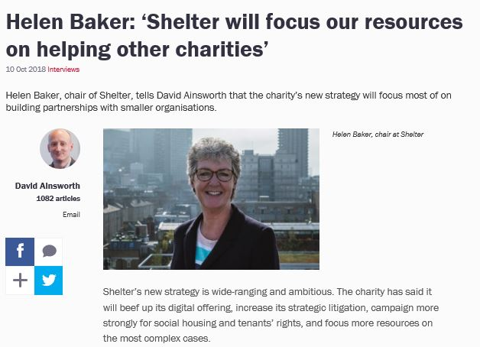
Local Offer Vision
Shelter Hubs will be designed with the community and for the community, working in partnership with local agencies and groups – putting the community at the heart of the Hub – not outposts of a national charity. They will be the public living room space for the use of the community.
Shelter’ Hubs deliver local services but are nationally assured with a strong brand and reputation.

Slide 9
Key Goals for the Norwich Hub
Deliver services that meet local need with a particular focus on people with MCN and consider how to deliver services in other key areas of the county.
In order to be a base for change we will work with key local partners to understand the systems change that is needed and to encourage organisations to be part of that change to deliver evidence based interventions that are designed around what matters to people.
We will ensure that people with lived experience are fully involved in designing and delivering the services we offer- working in partnership with other agencies such as The Feed creating opportunities for participation, whilst also offering leadership to grass roots organisations.

Slide 10
If you would like to discuss this further or want to know more contact
Lesley Burdett, Hub Manager lesleyb@shelter.org.uk

