Slide 1

Introduction to MEAM
Greater Norwich Homelessness Forum
April 2019
Georgina Beadon
Partnerships Manager
London & South East

Slide 2
Overview:
Introduction to MEAM
The MEAM Approach
The national picture
Questions and discussion

Slide 3
MEAM:
Three national charities- not a government initiative
1,300 frontline members
Formed because people move between sectors and are poorly supported
Remit to focus on policy and practice change

Slide 4
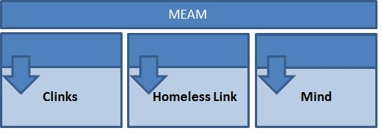
Why a collaboration?
Best way to tackle intractable problems in a ‘messy’ world
Embedded teams – no ‘separate’ organisation
Model the collaboration we want to see from government and services

Slide 5
What do we mean by multiple disadvantage?
Lankelly Chase’s Hard Edge’s Report:
‘Severe and Multiple Disadvantage’ areas including:
SMD 1: Homelessness (usually rough sleeping)
SMD 2: Substance misuse
SMD 3: Contact with the criminal justice system
SMD 4: Mental ill health
Could additionally include:
Domestic violence/sexual assault/sex work
Chronic and acute physical health issues
Learning difficulties (dyslexia, dyspraxia, ADHD) and learning disabilities (autism and other broader conditions, usually undiagnosed)

Slide 6
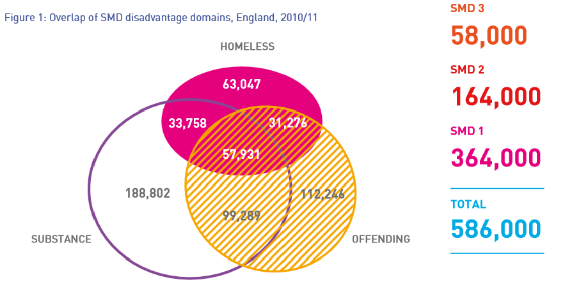
Source: Bramley, Fitzpatrick et al (2015) Hard Edges: Mapping severe and multiple disadvantage, LankellyChase Foundation, London, p.13

Slide 7
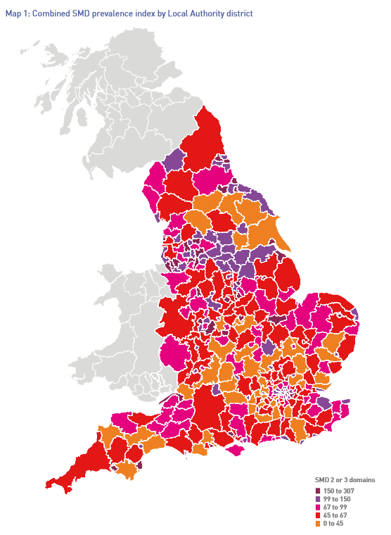
SMD3 = 58,000 people
380 people per local authority area (average)
Figures strongly correlated to poverty and deprivation
LAs at the of the list have a prevalence 2-3 times the national average.
Figures under-represent women and people from BAME communities
Source: ibid, p.24-25

Slide 8
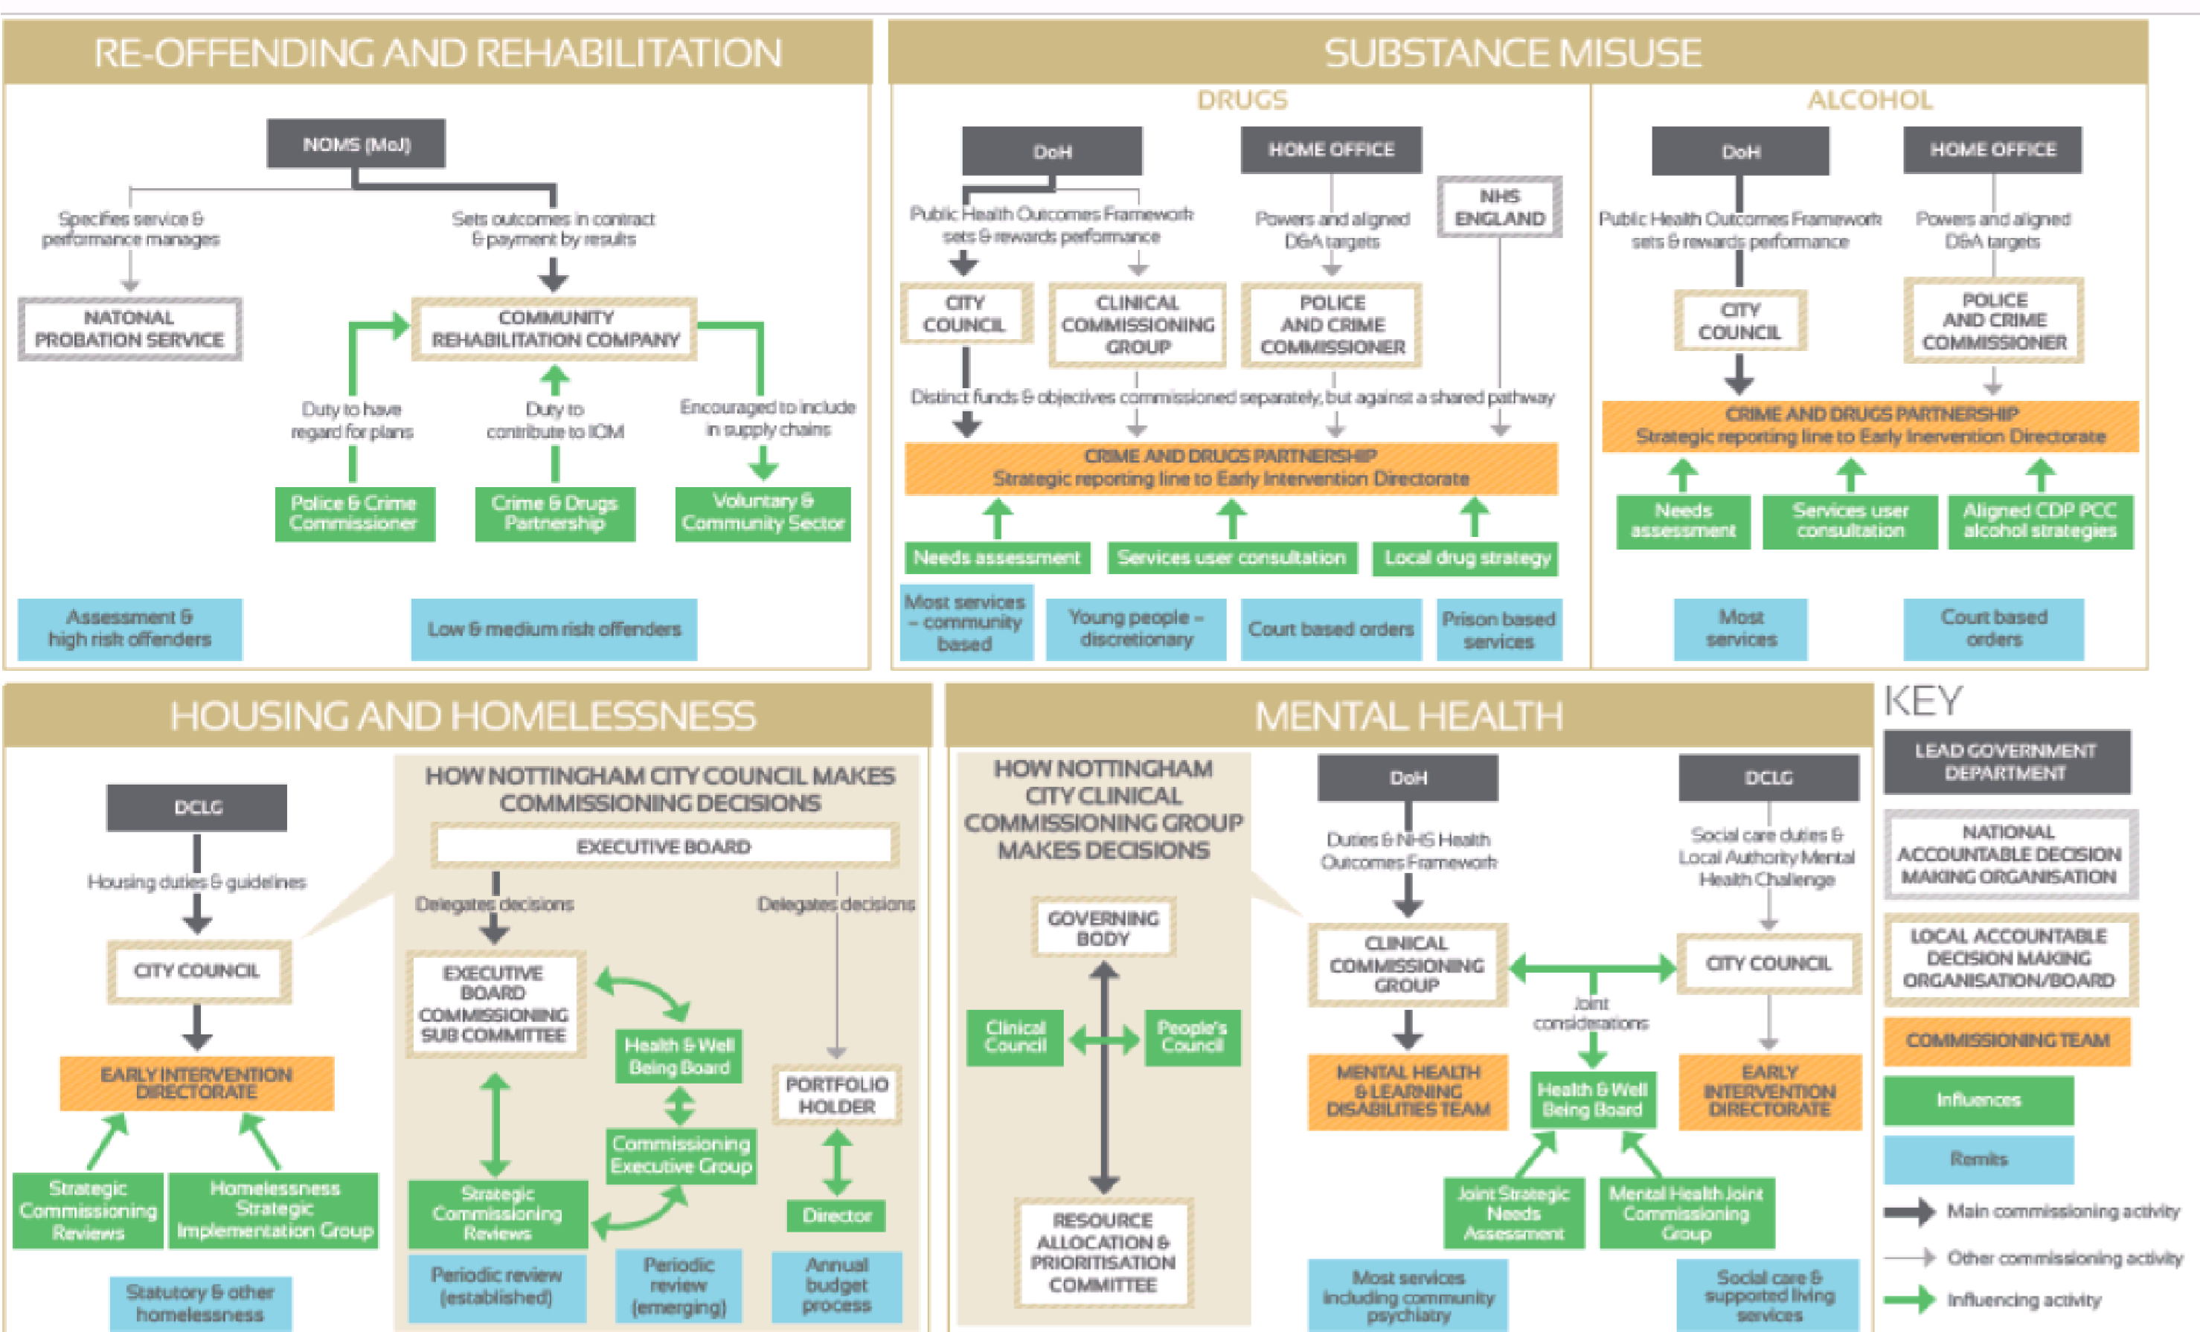

Slide 10
What are we doing about it?
Our vision:
That everyone experiencing multiple needs can reach their full potential and contribute to their communities.
Mission
Working together as a coalition, we support local areas across England to develop effective, coordinated services for people with multiple needs. Our shared knowledge and practical experience allows us to influence policy at a national and local level.
Policy
Practice

Slide 11
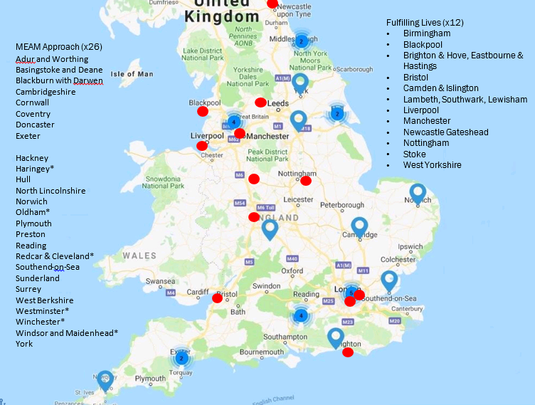

Slide 12
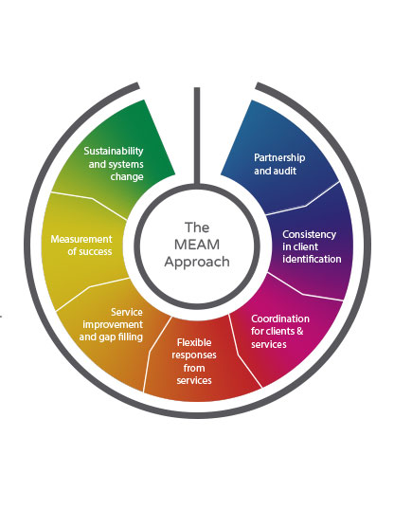
The MEAM Approach
Sustainability
Getting started
Planning your implementation – service models and flexible responses

Slide 13
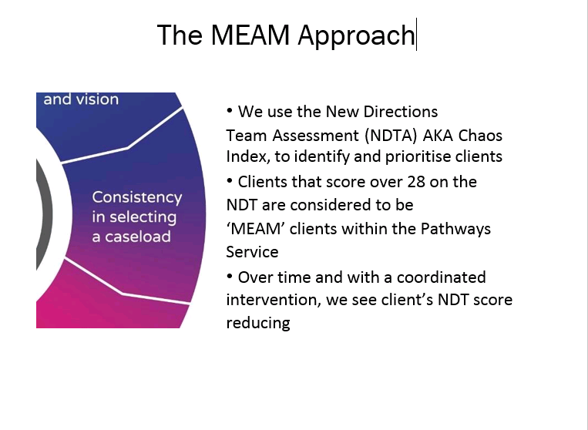

Slide 14
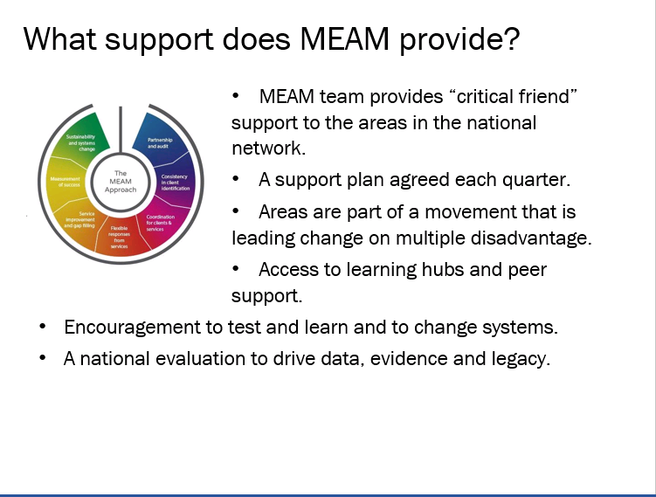

Slide 15

This quarter…
Coproduction workshop with follow up meeting
Community of Practice with
Homeless Link
Mental Health advocacy Learning
Hub
Training on trauma informed
working to volunteers
Support at strategic meeting
Support with evaluation
Support at practitioner events

Slide 16
Er…what’s systems change?
What’s your definition of it? What could it mean?
https://lankellychase.org.uk/resou rces/publications/systems-changea-guide-to-what-it-is-and-how-to-doit/

Slide 17
Systems change is not simply about implementing new projects; it is about doing things differently, and is a process rather than a project. It requires new facilitative forms of leadership and extensive collaboration.

Slide 18
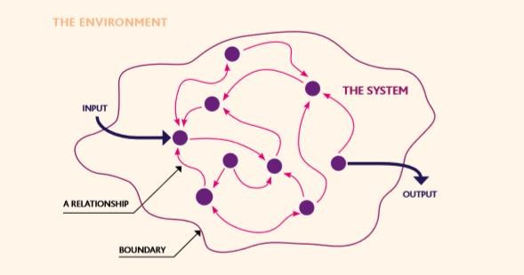
What does a system look like?

Slide 19
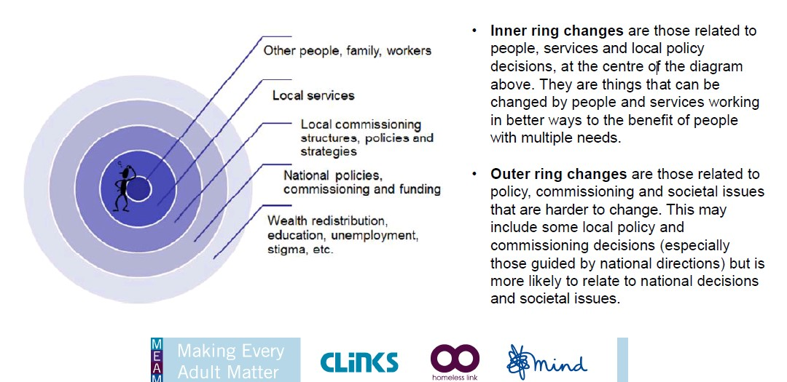

Slide 20
Systems blocks in Norwich
What are some examples of systems blocks or issues in Greater Norwich?

Slide 21

Thank you
What support could you, your staff or your organisation benefit from, from me and MEAM?
Please contact me on g.beadon@mind.org.uk
I will send these slides on to Victoria/Chris to disseminate to you
g.beadon@mind.org.uk
www.meam.org.uk
@meamcoalition

